Slide 1
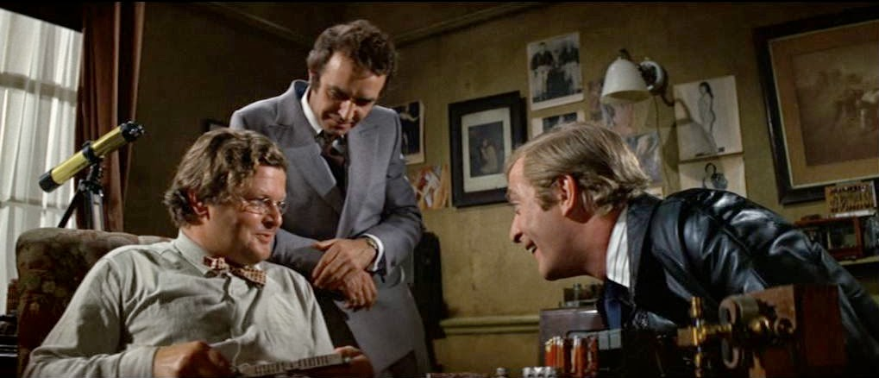
Scenario X
Real Time Audio Descrambler
Outline
Introduction (problem to be solved)
Analogue Solution
Digital Solution
Problems / Summary / Conclusion
Professor Peach, The Italian Job (1969)
“I like them big”

Slide 2
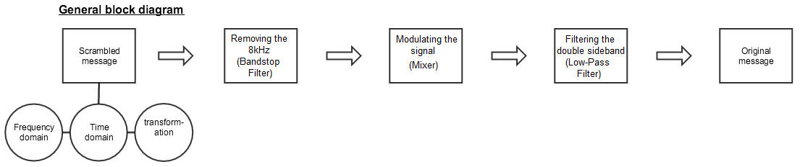
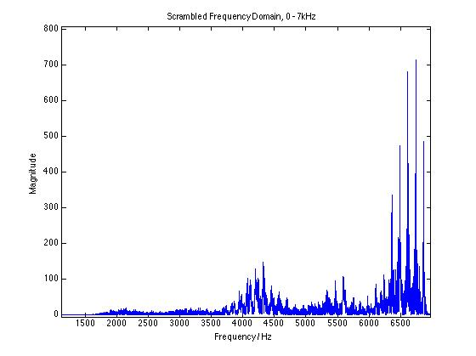
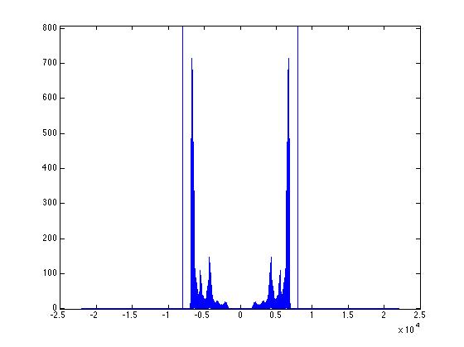
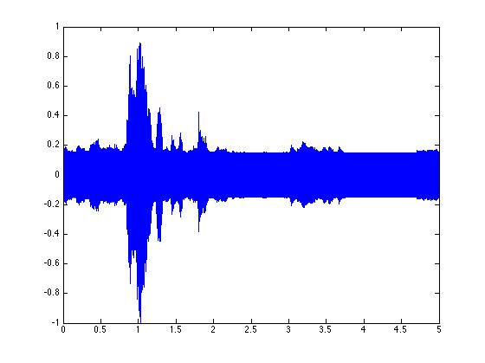
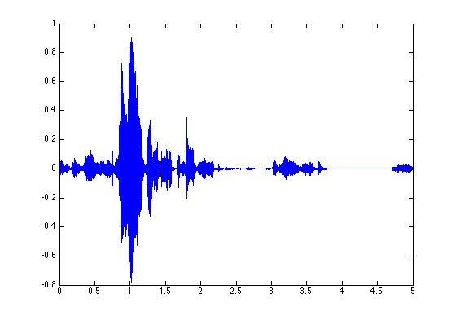
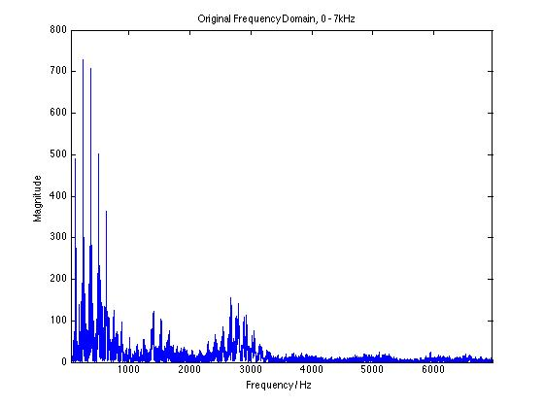
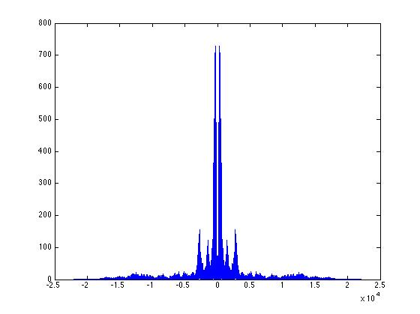
Introduction
Notes:
Block diagram for both systems + introduce the problem + our initial observations in the time and frequency domain via Matlab analysis.
Reference to professor Peach and Benny Hill (computer expert ->traffic jam for robbery)
Matlab immediately notice the voice inversion scrambling and added 8khz tone, from there followed the deduction seen in the block diagram.

Slide 3
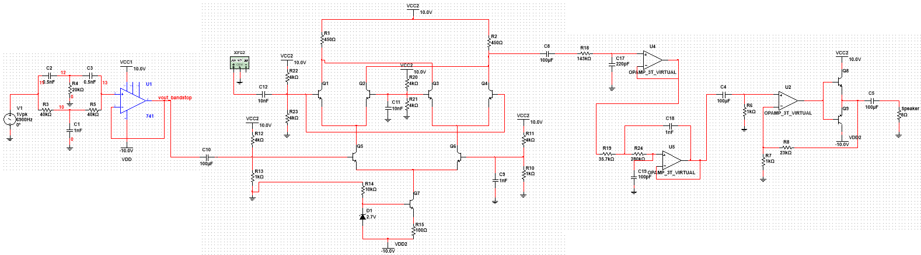
Analogue Solution
Fig. 1 Complete Multisim (Spice Model) based circuit
Notes:
Firs stage – Bandstop Filter

Slide 4
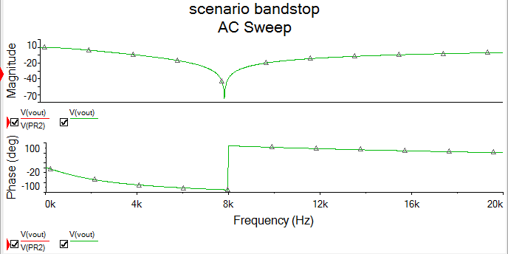
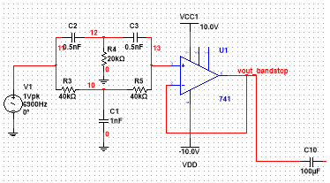
Analogue First Stage – Bandstop
(Twin-T active notch filter)
Fig. 2 Bandstop filter (active twin-t notch filter topology)
Fig. 3 Bandstop Filter Bode plot AC sweep (simulated)
Notes:
Our goal is to eliminate that 8Khz tone – a 4th order active twin-t notch filter is thus used with an accurate elimination of the tone as seen in the bode plot simulation.
A funny thing is that the t based network ideally shows a nice Q factor making the the attenuation very sharp (in practice this is obtained by adding another voltage buffer stage), in practice however it tends not to be very sharp but does the job as it makes sure to get rid of the 8kHz tone and any noise surrounding it (but the trade off remains as our signal is attenuated slightly earlier then I should)

Slide 5
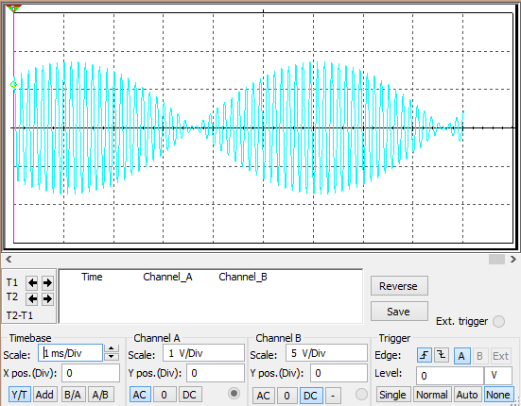
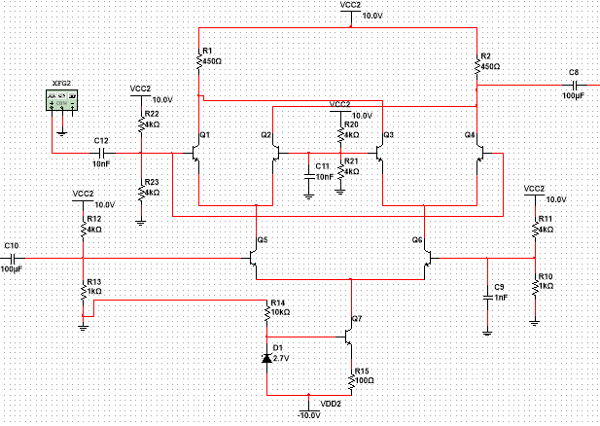
Analogue Second Stage – Mixer
(Gilbert Cell Analogue Multiplier)
Fig. 4 Gilbert Cell Analogue Multiplier
Fig. 6 Gilbert Cell output analysis (phase reversal, envelope, carrier)
Notes:
The output analysis was set using a small frequency (100Hz) at the input of the bandstop that is coupled to the mixer and the carrier set at 7Khz.
!!!Multiplying two signals in the time domain = shifting or summing them up in the frequency domain!!! -> this leads to an understanding of what we should observe at the output of the mixer and the overall circuit (i.e: phase reversals to confirm envelope and frequency difference equivalent sinusoid at the output of the circuit -> ex: 7kHz – 6.9kHz input signals give birth to a 100Hz total output signal).
The cell comprises of the main 6 biased transistors (upper stages being more forward biased than the lower stages) and a current mirror at the tail of the latter to provide an ideal current source.
The 6 transistors can easily be shown to switch on and off thus defining the essential function of the cell. We are mixing the carrier with our input signal by switching transistors on and off. The carrier controls this and on general the latter is a square wave in RF applications, this is mixing. It is also an active mixer and can introduce gain.
Capacitive coupling also plays a very important role.

Slide 6
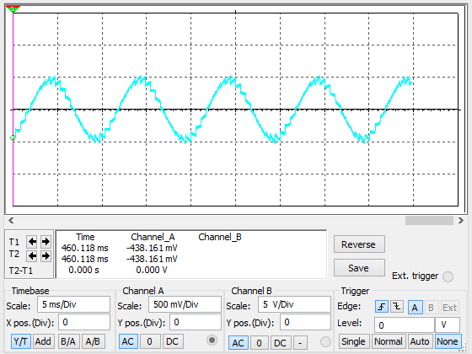
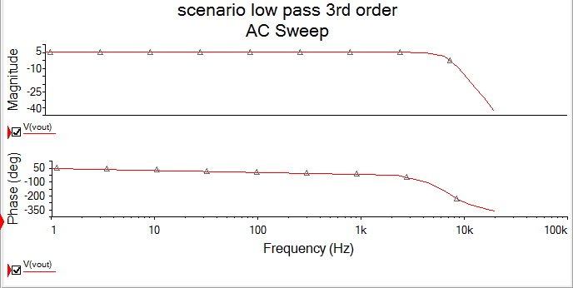
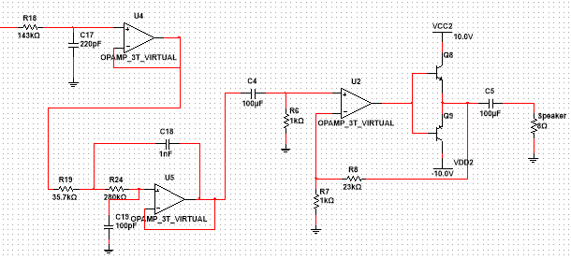
Analogue Third and Fourth Stages –
Low Pass filter and Power Gain Amplifier
Fig. 7 Third order Low-pass Filter and Class B gain Stage
Notes:
Third order is used to provide the sharpest cut off, many topologies exist, ours worked fine in practice
Our 8ohm speaker was rated at 0.3W we thus need to provide a maximum amount of current and power to maximize the sound at the output. Since we already had sufficient current we finally resorted in only taking the non-inverting stage to amplify our voltage to the load.

Slide 7
Digital Solution
Similar approach to analogue team
  3 distinct stages: ADC – Filtering – DAC
DC biasing before ADC
ADC software based
Filtering done through ‘fdatool’ Matlab
Matlab code → C code
DAC (R-2R)
Power Amplifier

Slide 8
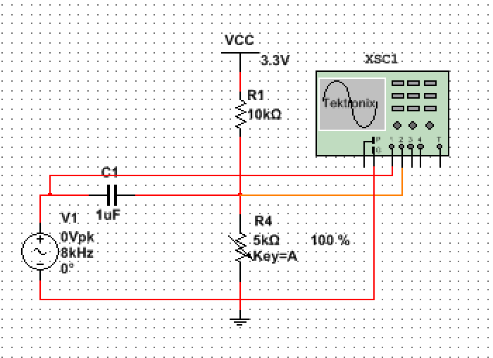
Potentiometer biasing
Before ADC implemented a DC biasing circuit using potentiometer
MSP432 cannot read negative voltages
  Shifted the signal ~0.6V upwards in the time domain.
  Entire signal only positive.
Simple potentiometer biasing circuit to give the output from 0 to ~1.2V

Slide 9
Analogue to Digital Conversion
Input signal from audio

Slide 10
Filtering
Attained coefficients using ‘fdatool’ on Matlab
Implemented the coefficients into C

Slide 11
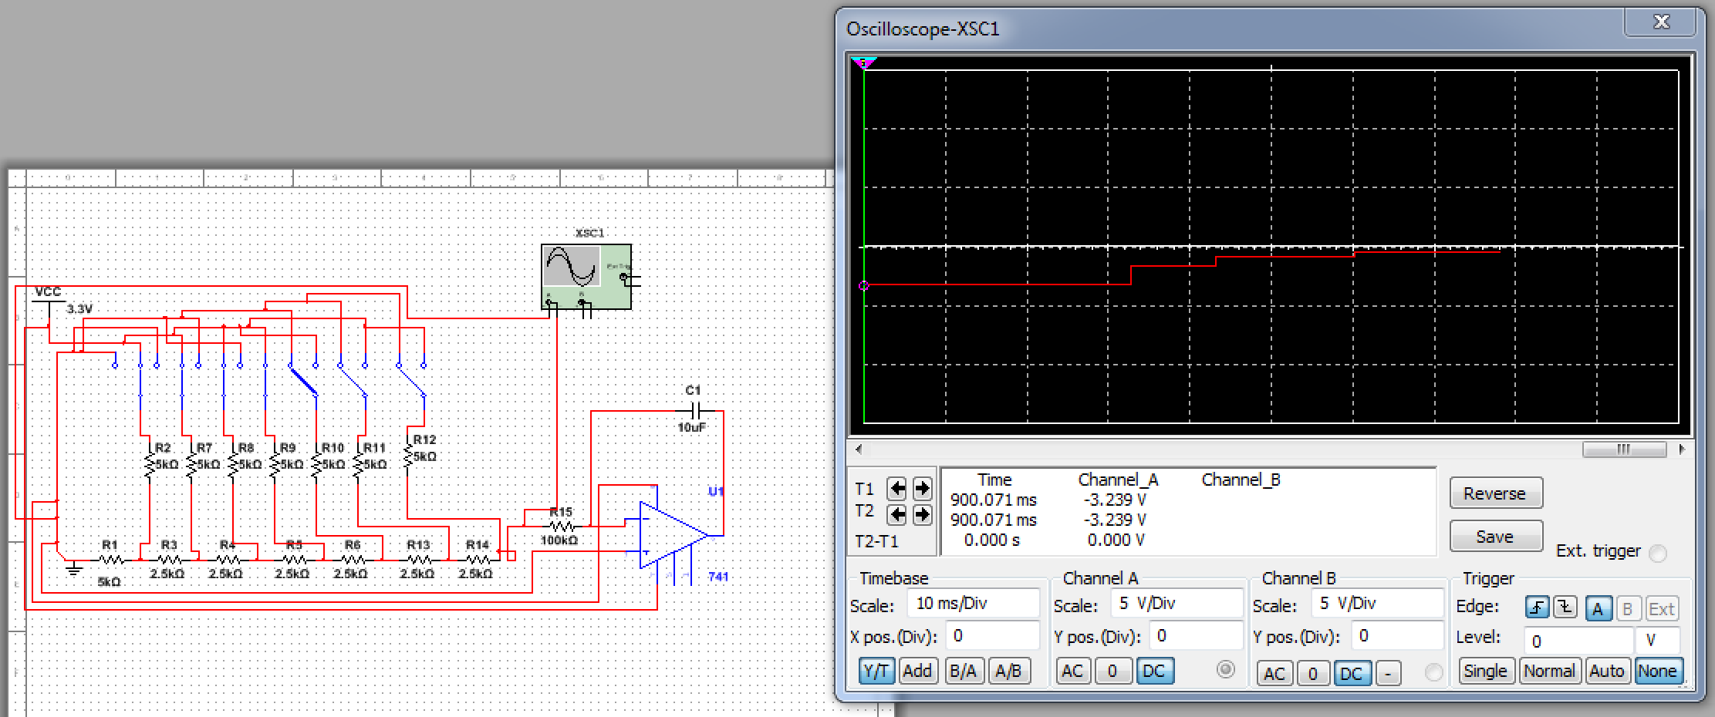
R-2R Ladder (DAC)
Chose R values based on the output voltage range
  Initially tried to use an integrator to smoothen the signal, however it was already smooth enough to be played

Slide 12
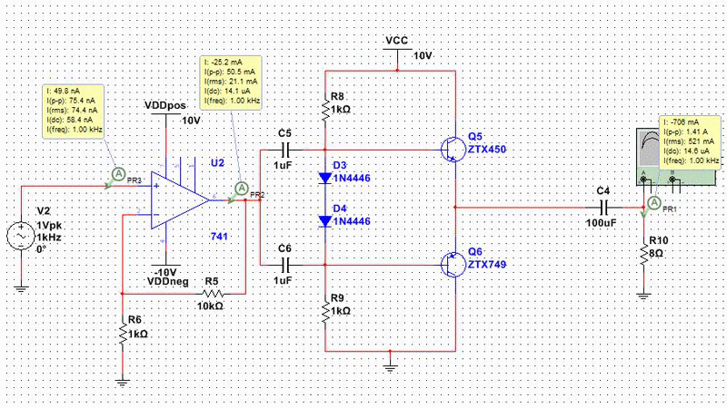
Power amplifier
Very low output current from MSP432
  Due to many resistors from R-2R
  Current not large enough to drive the loudspeaker
Class AB amplifier built (power amplifier)

Slide 13
Problems Encountered
Analogue:
  Non ideal properties of the circuit (in contrast to Multisim based circuit)
  Gain losses as we implemented stages
  Capacitor coupling! (higher values than simulation)
Digital:
  DC biasing needed to be accurate to feed in the correct range of Voltage values to be read by the MSP432
  Very low current from the output stage of the DAC (in the range of microamps)

Slide 14
Summary / Conclusion
Overview / best solution to date
Advantages and disadvantages of one solution over the other

